Slide 1
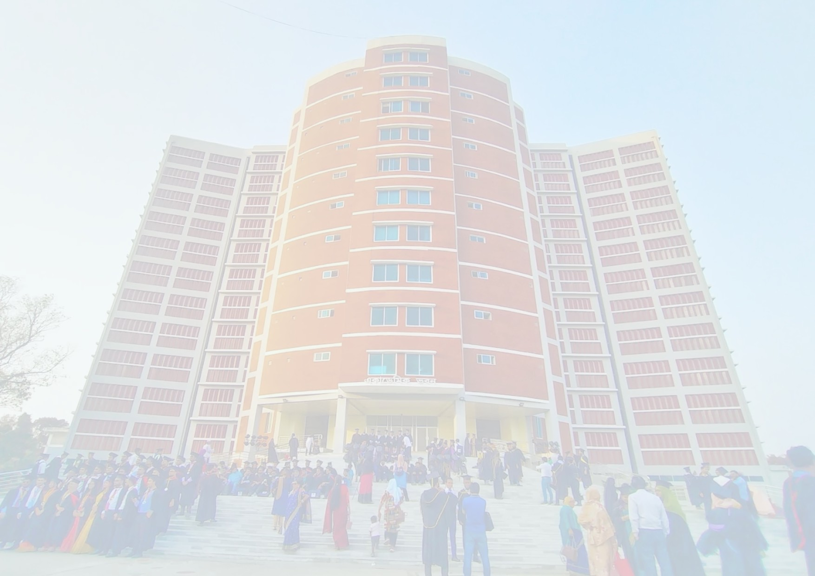


Data Communication
Mawlana Bhashani Science and Technology University
Santosh, Tangail, Bangladesh
TLS(Transport Layer security): Securing data communication over the internet.
[Isratul bari Wasi]
[IT24056]
Department of ICT, Mawlana Bhashani Science and Technology University, Bangladesh
Submitted to: [Dr. Nazrul Islam]
Date:6/11/26
[

Slide 2
Presentation Outline
01
Introduction and security problem
02
Evolution from SSL to TLS
03
TLS architecture and handshake
04
Record protocol and version comparison
05
Conclusion
02

Slide 3
Introduction and Security Problem
Data crossing the internet can be read, altered or faked by anyone on the path.
01
Why it matters: banking, e-mail and logins cross untrusted networks
02
What plain TCP leaves open: no encryption, no integrity, no peer identity
03
Objective: see how TLS gives confidentiality, integrity and authentication
03

Slide 4
Evolution from SSL to TLS
Version | Key idea | Relevant limitation
SSL 2.0 / 3.0 | Netscape protocols for encrypted web traffic | Weak design; SSL 3.0 broken by POODLE, banned in RFC 7568
TLS 1.0 / 1.1 | IETF standard successor to SSL 3.0 | Outdated ciphers; deprecated in RFC 8996
TLS 1.2 | Flexible cipher suites, AEAD support | Two-round-trip handshake; unsafe options still allowed
Research gap
Need a faster handshake and secure defaults: TLS 1.3
04

Slide 5
Where TLS Fits
Application HTTP, SMTP, IMAP
01
Confidentiality
Encryption hides the data from eavesdroppers
TLS Secure channel
02
Integrity
TCP Reliable delivery
Any tampering with records is detected
IP Routing
03
Authentication
Link Ethernet, Wi-Fi
Certificates prove the server's identity
05

Slide 6
TLS 1.3 Handshake
Client and server agree on keys in one round trip
Client
Server
01
Negotiate
ClientHello + key share
Agree on version and cipher suite; swap key shares
ServerHello + key share
02
Authenticate
Certificate, Finished (encrypted)
Server certificate is checked against a trusted CA
Client Finished
03
Protect
Application data
Derived keys encrypt all further data
06

Slide 7
TLS Record Protocol
Fragmentation
Data is split into records of up to 16 KB
Protection
AEAD ciphers: AES-GCM, ChaCha20-Poly1305
Integrity
Authentication tag and sequence number per record
Key exchange
Ephemeral (EC)DHE gives forward secrecy
07

Slide 8
Handshake Cost: Round Trips
Main finding
TLS 1.3 needs one round trip, half of TLS 1.2.
Resumption can send data at once (0-RTT), but early data can be replayed.
RTT before application data, TCP handshake excluded
08

Slide 9
Version Comparison
Version | Handshake | Forward secrecy | Status
SSL 3.0 | 2 RTT | Optional | Deprecated
TLS 1.2 | 2 RTT | Optional | Widely used
TLS 1.3 | 1 RTT | Always | Recommended
TLS 1.3 halves handshake latency and makes forward secrecy the default.
09

Slide 10
Conclusions and Future Work
TLS protects data in transit through authentication, key exchange and encrypted records.
01
Contribution: TLS 1.3 is faster and drops weak legacy options
02
Limit: endpoints, CA trust and 0-RTT replay remain risks
03
Next step: post-quantum key exchange for TLS
10

Slide 11
Selected References
[1] E. Rescorla, “The Transport Layer Security (TLS) Protocol Version 1.3,” RFC 8446, IETF, 2018.
[2] T. Dierks and E. Rescorla, “The TLS Protocol Version 1.2,” RFC 5246, IETF, 2008.
[3] R. Barnes et al., “Deprecating Secure Sockets Layer Version 3.0,” RFC 7568, IETF, 2015.
[4] K. Moriarty and S. Farrell, “Deprecating TLS 1.0 and TLS 1.1,” RFC 8996, IETF, 2021.
11

Slide 12
Thank you
Questions and Discussion
[Presenter name]:
Isratul bari Wasi
Department of ICT, Maulana Bhashani Science and Technology University
[it24056@mbstu.ac.bd]
12

